Slide 1
Implementing Azure Active Directory
Creating and managing Azure AD tenants
Configuring application and resource access with Azure AD
Administering Active AD
Configuring SSO
Configuring Multi-Factor Authentication

Slide 2
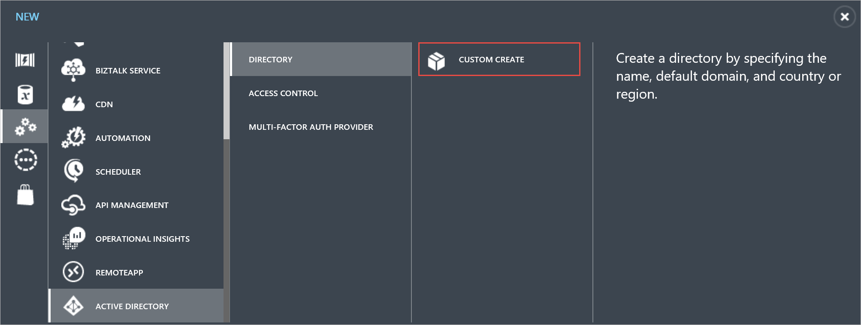
Creating and managing Azure AD tenants
Create an Azure Active Directory tenant
To create a Data Catalog app, you need an Azure Active Directory (Azure AD) tenant.
Here's how to set up Azure Active Directory:
Navigate to https://manage.windowsazure.com and log in with the account that has an Azure subscription.
Click ACTIVE DIRECTORY management icon in the left pane.
Click NEW button at the bottom of the page.
Choose APP SERVICES > ACTIVE DIRECTORY > DIRECTORY > CUSTOM CREATE.

Slide 3
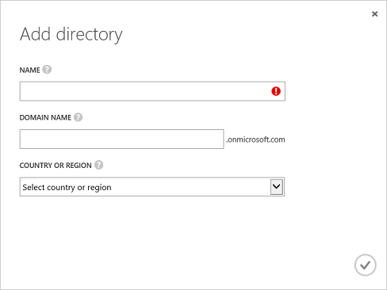
In the Add directory page, enter a name and domain name. For country or region, choose United States or the country where Data Catalog is available.
Choose OK icon. An Azure Active Directory is created.

Slide 4
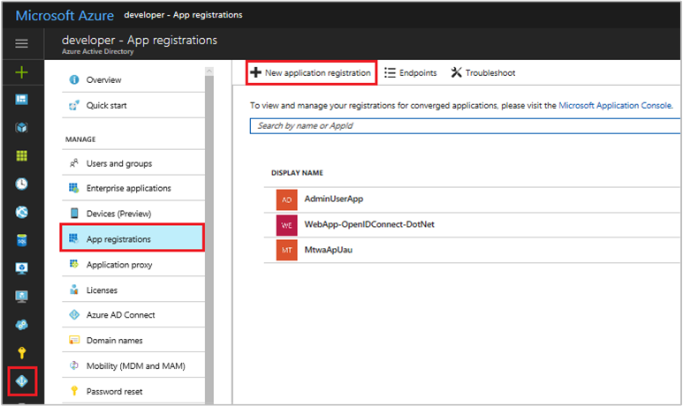
To register a new application using the Azure portal
Sign in to the Azure portal.
If your account gives you access to more than one, click your account in the top right corner, and set your portal session to the desired Azure AD tenant.
In the left-hand navigation pane, click the Azure Active Directory service, click App registrations, and click New application registration.

Slide 5
When the Create page appears, enter your application's registration information:
Name: Enter a meaningful application name
Application type:
Select "Native" for client applications that are installed locally on a device. This setting is used for OAuth public native clients.
Select "Web app / API" for client applications and resource/API applications that are installed on a secure server. This setting is used for OAuth confidential web clients and public user-agent-based clients. The same application can also expose both a client and resource/API.
Sign-On URL: For "Web app / API" applications, provide the base URL of your app. For example, http://localhost:31544 might be the URL for a web app running on your local machine. Users would use this URL to sign in to a web client application.
Redirect URI: For "Native" applications, provide the URI used by Azure AD to return token responses. Enter a value specific to your application, for example http://MyFirstAADApp

Slide 6
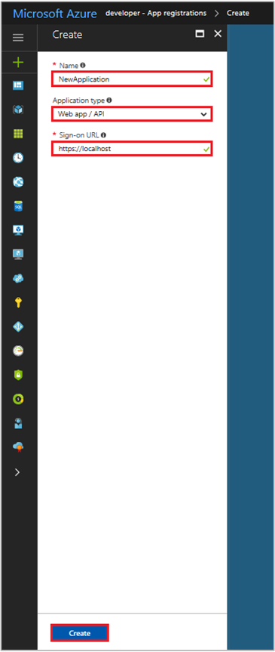
When finished, click Create. Azure AD assigns a unique Application ID to your application, and you're taken to your application's main registration page. Depending on whether your application is a web or native application, different options are provided to add additional capabilities to your application. See the next section for an overview of consent, and details on enabling additional configuration features in your application registration (credentials, permissions, enable sign-in for users from other tenants.)

Slide 7
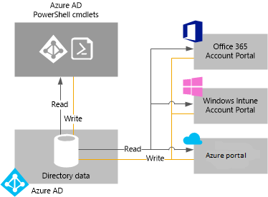
Administering Active AD
In Azure Active Directory (Azure AD), a tenant is a dedicated instance of an Azure AD directory that your organization receives when it signs up for a Microsoft cloud service such as Azure or Office 365. Each Azure AD directory is distinct and separate from other Azure AD directories. Just like a corporate office building is a secure asset specific to only your organization, an Azure AD directory was also designed to be a secure asset for use by only your organization. The Azure AD architecture isolates customer data and identity information so that users and administrators of one Azure AD directory cannot accidentally or maliciously access data in another directory.

Slide 8
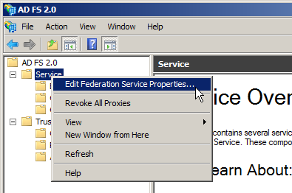
Configuring SSO
Step 1. ADFS 2.0 Configuration
Consider that for the current procedure, your ADFS 2.0 server is hosted in win-0sgkfmnb1t8.adatum.com. (Do not forget to replace win-0sgkfmnb1t8.adatum.com with your ADFS 2.0 server actual domain name when following this procedure).
Open the ADFS 2.0 Management through Start→Administrative Tools→ADFS 2.0 Management.
Right-click on Service from the left tree-view and click on Edit Federation Service Properties.

Slide 9
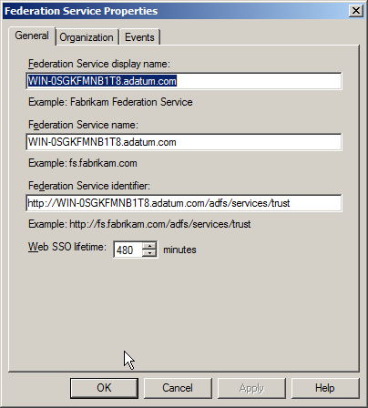
In the General Tab you can find the Federation Service Identifier, which is the Identity provider URL. You’ll need to fill this up in the TalentLMS Single-Sign-On (SSO) configuration page. For the current procedure the Identity provider URL is http://win-0sgkfmnb1t8.adatum.com/adfs/services/trust. Check the rest values in General Tab and confirm that they match your DNS settings for your server.
Click on the Certificates Entry from the left tree-view, right-click on Token-Signing certificate and then click on View Certificate

Slide 10
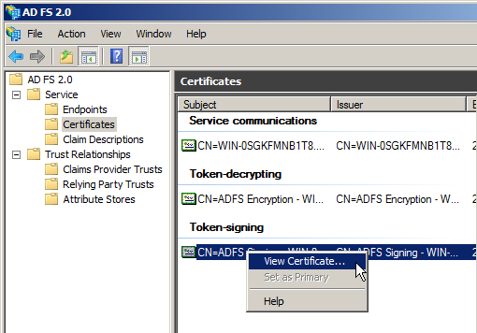
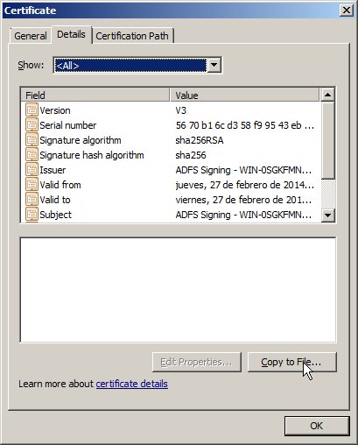
In the Details Tab click on Copy to File and theCertificate Export Wizard launches. Click on Next, select DER encoded binary X.509 (.cer) format, and then click Next. Choose where you want to save the certificate and click on Finish.

Slide 11
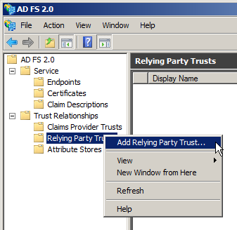
Step 2. ADFS 2.0 Relying Party Trust Configuration
Select Relying Party Trusts from the left tree-view under the Trust Relationships,right-click on the Relying Party Trusts and click on Add Relaying party Trust. The wizard launches.

Slide 12
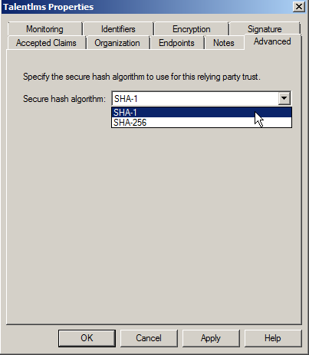
Click on Start and Choose Import data about the relying party from a file.Click on Browse and locate the Metadata XML file of your TalentLMS domain.
Click on Next, ignore the pop-up message and type a distinctive Display Name (eg. Talentlms) and click Next.
Select Permit all users to access the relying party and click Next to Finish.
On the center Column right-click on the relying part you’ve just created (eg TalentLMS) and the select Properties.
On the Advanced Tab select SHA-1 for the Secure hash algorithm and click on OK

Slide 13
Step 3. ADFS 2.0 Claim Rules Configuration
In order to configure a proper communication between your ADFS and TalentLMS, you should define the Claim Rules
On the center Column right-click on the relying part you’ve just created (eg TalentLMS) and then select Edit Claim Rules.
On the Issuance Transform Rules Tab click on Add Rules. The wizard launches.
Select Send LDAP Attribute as Claims and click on Next
Define the Claim rule name (eg. Get LDAP Attributes) and select Active Directory in Attribute Store. In the Mapping of LDAP attributes to outgoing claim type select the following: LDAP Attribute: E-Mail-Addresses, Outgoing Claim Type: E-mail Address LDAP Attribute: Given-Name, Outgoing Claim Type: Given Name LDAP Attribute: Surname, Outgoing Claim Type: Surname LDAP Attribute: User-Principal-Name, Outgoing Claim Type: UPN and then click on Finish
Add a second Rule following the same procedure. Select Transform an Incoming Claim and click on Next.
Define the Claim rule name (eg. Email to Name ID) and set Incoming claim Type as E-Mail Address (the same one from the previous rule), Outgoing claim type as Name ID and Outgoing name ID format as Email. Then click on Finish. Have in mind that the email should be defined in all users to achieve a proper communication between your ADFS and TalentLMS.

Slide 14
Step 4. Enabling SAML SSO in your TalentLMS domain
Login to your TalentLMS domain as a super-admin and go to Account & Settings → Users. If your subscription plan supports SSO Integrations (currently supported in Basic, Plus and Premium plans), you can click on Single Sign-On (SSO)link.
In this page you should fill-in information regarding your Identity Provider (ADFS 2.0). All the required information can be retrieved from the IdP’s Metadata XML that can be found in the following URL:
https://win-0sgkfmnb1t8.adatum.com/FederationMetadata/2007-06/FederationMetadata.xml
Do not forget to replace win-0sgkfmnb1t8.adatum.com with the domain name of your ADFS 2.0
SSO integration type: Choose SAML2.0 from the drop-down list
Identity provider (IdP): type the Identity Provider's (IdP) URL http://win-0sgkfmnb1t8.adatum.com/adfs/services/trust

Slide 15
Configuring Multi-Factor Authentication
Block a user
Sign in to the Azure portal as an administrator.
Browse to Azure Active Directory > MFA Server > Block/unblock users.
Select Add to block a user.
Select the Replication Group. Enter the username for the blocked user as username@domain.com. Enter a comment in the Reasonfield.
Select Add to finish blocking the user.
Unblock a user
Sign in to the Azure portal as an administrator.
Browse to Azure Active Directory > MFA Server > Block/unblock users.
Select Unblock in the Action column next to the user to unblock.
Enter a comment in the Reason for unblocking field.
Select Unblock to finish unblocking the user.

Slide 16
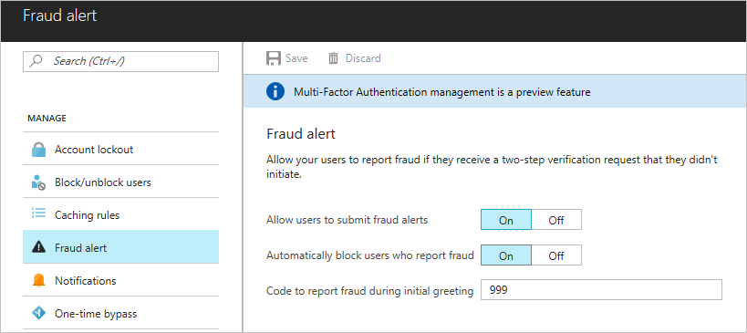
Fraud alert
Configure the fraud alert feature so that your users can report fraudulent attempts to access their resources. Users can report fraud attempts by using the mobile app or through their phone.
Turn on fraud alerts
Sign in to the Azure portal as an administrator.
Browse to Azure Active Directory > MFA Server > Fraud alert.
Set the Allow users to submit fraud alerts setting to On.
Select Save.

Slide 17
View fraud reports
Sign in to the Azure classic portal.
On the left, select Active Directory.
Select the directory that you want to manage.
Select Configure.
Under Multi-Factor Authentication, select Manage service settings.
At the bottom of the Service Settings page, select Go to the portal.
In the Azure Multi-Factor Authentication Management Portal, under View A Report, select Fraud Alert.
Enter the date range that you want to view in the report. You can also specify usernames, phone numbers, and the user's status.
Select Run to view a report of fraud alerts. To export the report, select Export to CSV.

